Slide 1
Facilities
February 27, 2020

Slide 2
Facilities – AiM – Work Order System https://aimweb.kennesaw.edu/

Slide 3
Facilities – Building Information
(Source: Facilities Inventory Data Collection/ USG Data Store, Spring 2019)
Notes:
Acres does not include “In The Valley” or Rose Drive.
All categories show the total building GSF, including the unassignable (mechanical, corridors, etc) space.
Leased – Marietta – Stingers Restaurant, Columns activity center
Leased – Kennesaw – Campus Loop Road 6 houses, Chastain Pointe, Stadium, Owls Nest, SRAC, Commons Dining Hall, Town Point

Slide 4
GSF (Gross Square Feet) of KSU Space By Space Type
Category | Type/Use of Space | Kennesaw Campus | Marietta Campus | GSF TOTAL
100 | Classrooms + Service | 149,653 | 62,160 | 211,813
200 | Discipline Classrooms, Laboratories + Service | 269,764 | 181,509 | 451,273
300 | Office (includes Administrative areas and conference rooms) | 578,396 | 152,107 | 730,503
400 | Library and Study Space | 73,026 | 45,742 | 118,768
500 | Special Use | 263,624 | 55,489 | 319,113
600 | General Use | 155,297 | 84,152 | 239,449
700 | Support (does not include parking decks) | 63,252 | 29,974 | 97,858
800 | Health Care | 2,998 | 759 | 3,757
900 | Residential/Student Housing | 1,358,449 | 419,199 | 1,777,648
000 | Unassignable (Mechanical/Utilities, Circulation, Restrooms) | 1,179,936 | 500,391 | 1,680,327
700 | Parking Decks | 2,089,678 | 273,280 | 2,362,958
 | TOTAL SF | 2,919091 | 1,031,091 | 7,993,467
(Source: Facilities Inventory Data Collection/ USG Data Store, Spring 2019)
Notes:
Space type is assigned to each room or area within a building.
500 – Special Use – Athletic, Physical (instructional and intercollegiate, intramural, recreational) (Rec Centers, Stadiums)
600 – General Use- Merchandising, Food Facility, Exhibition, Performance/General Assembly, (Student Centers)
700 – Support – Central Computer/Data centers, shops, central storage

Slide 5
Capital Projects
Fiscal Year | Project | Campus | Capital Outlay | Notes
2018 | Science Lab Annex to Engineering Lab Building | Marietta | $5,000,000 Design & Construction | Completion March, 2020
2018, 2017 | Chastain Pointe 115 Renovation for COTA / Visual Arts | Kennesaw | $2,970,000 | Completion April, 2020
2020 | Academic Learning Center | Kennesaw | $39,500,000 Construction | Completion Spring, 2022
2019 | Engineering Lab Building Renovation | Marietta | $5,000,000 Design & Construction | Construction Starts May, 2020
2020 | Howell Hall Renovation | Marietta | $12,000,000 | Completion July, 2021
2020 | New Housing Construction | Kennesaw | $37,000,000 | Completion July, 2022
2020 | Student Rec Center Renovation | Marietta | $5,000,000 | Integrated Review Underway
2021 | Science Building Chemistry Lab Renovation | Kennesaw | $2,000,000 | Included on FY21-24 Capital Plan

Slide 6
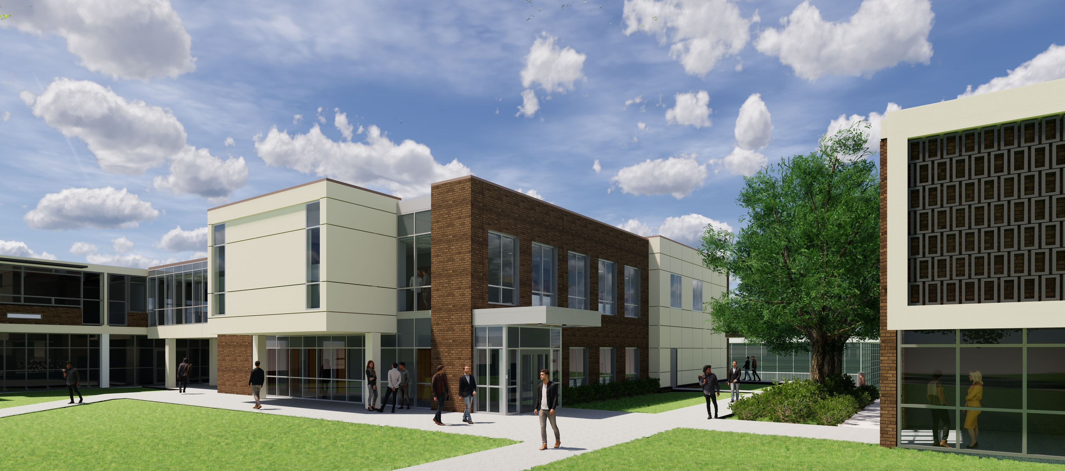
Marietta Campus:
Science Lab Annex to Engineering Lab Building (G)
Schematic Design / Construction Underway – Completion March 2020

Slide 7
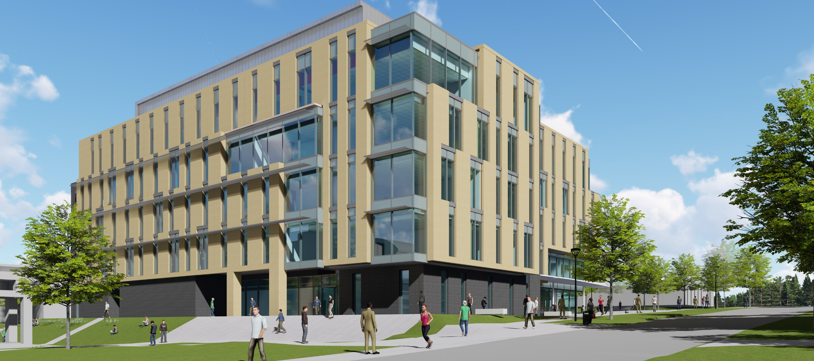
Kennesaw Campus
Academic Learning Center
Schematic Design / Ground-Breaking March 2020

Slide 8
Academic Learning Center, Level 1 Plan:
200 SEAT AUDITORIUM
MECHANICAL
LOADING
STAIRS/ ELEVATORS
SERVICE
ELEVATOR
RESTROOMS
80 SEAT CLASSROOM
STUDENT
STUDY
80 SEAT CLASSROOM
60 CLASSROOM

Slide 9
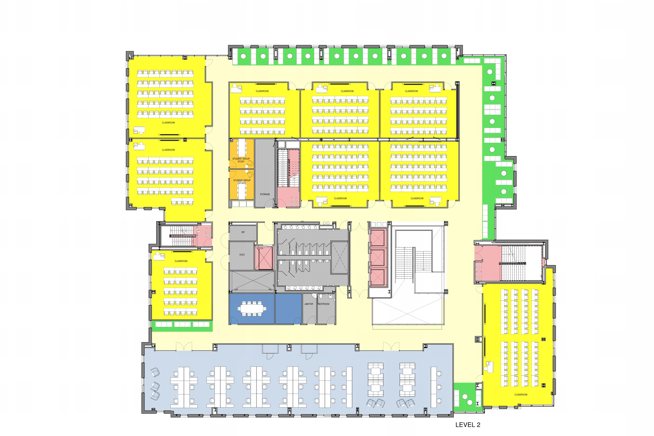
Academic Learning Center, Level 2 Plan:
50 PPL
30 PPL
40 PPL
40 PPL
FLOOR EXITING
STAIRS ACCOMMODATE:
720
TOTAL OCCUPANCY COUNT
±680
50 PPL
50 PPL
50 PPL
30 PPL
60 PPL
WORKSPACE
±40
Notes:
Academic Affairs – Group/Quiet Study Space

Slide 10
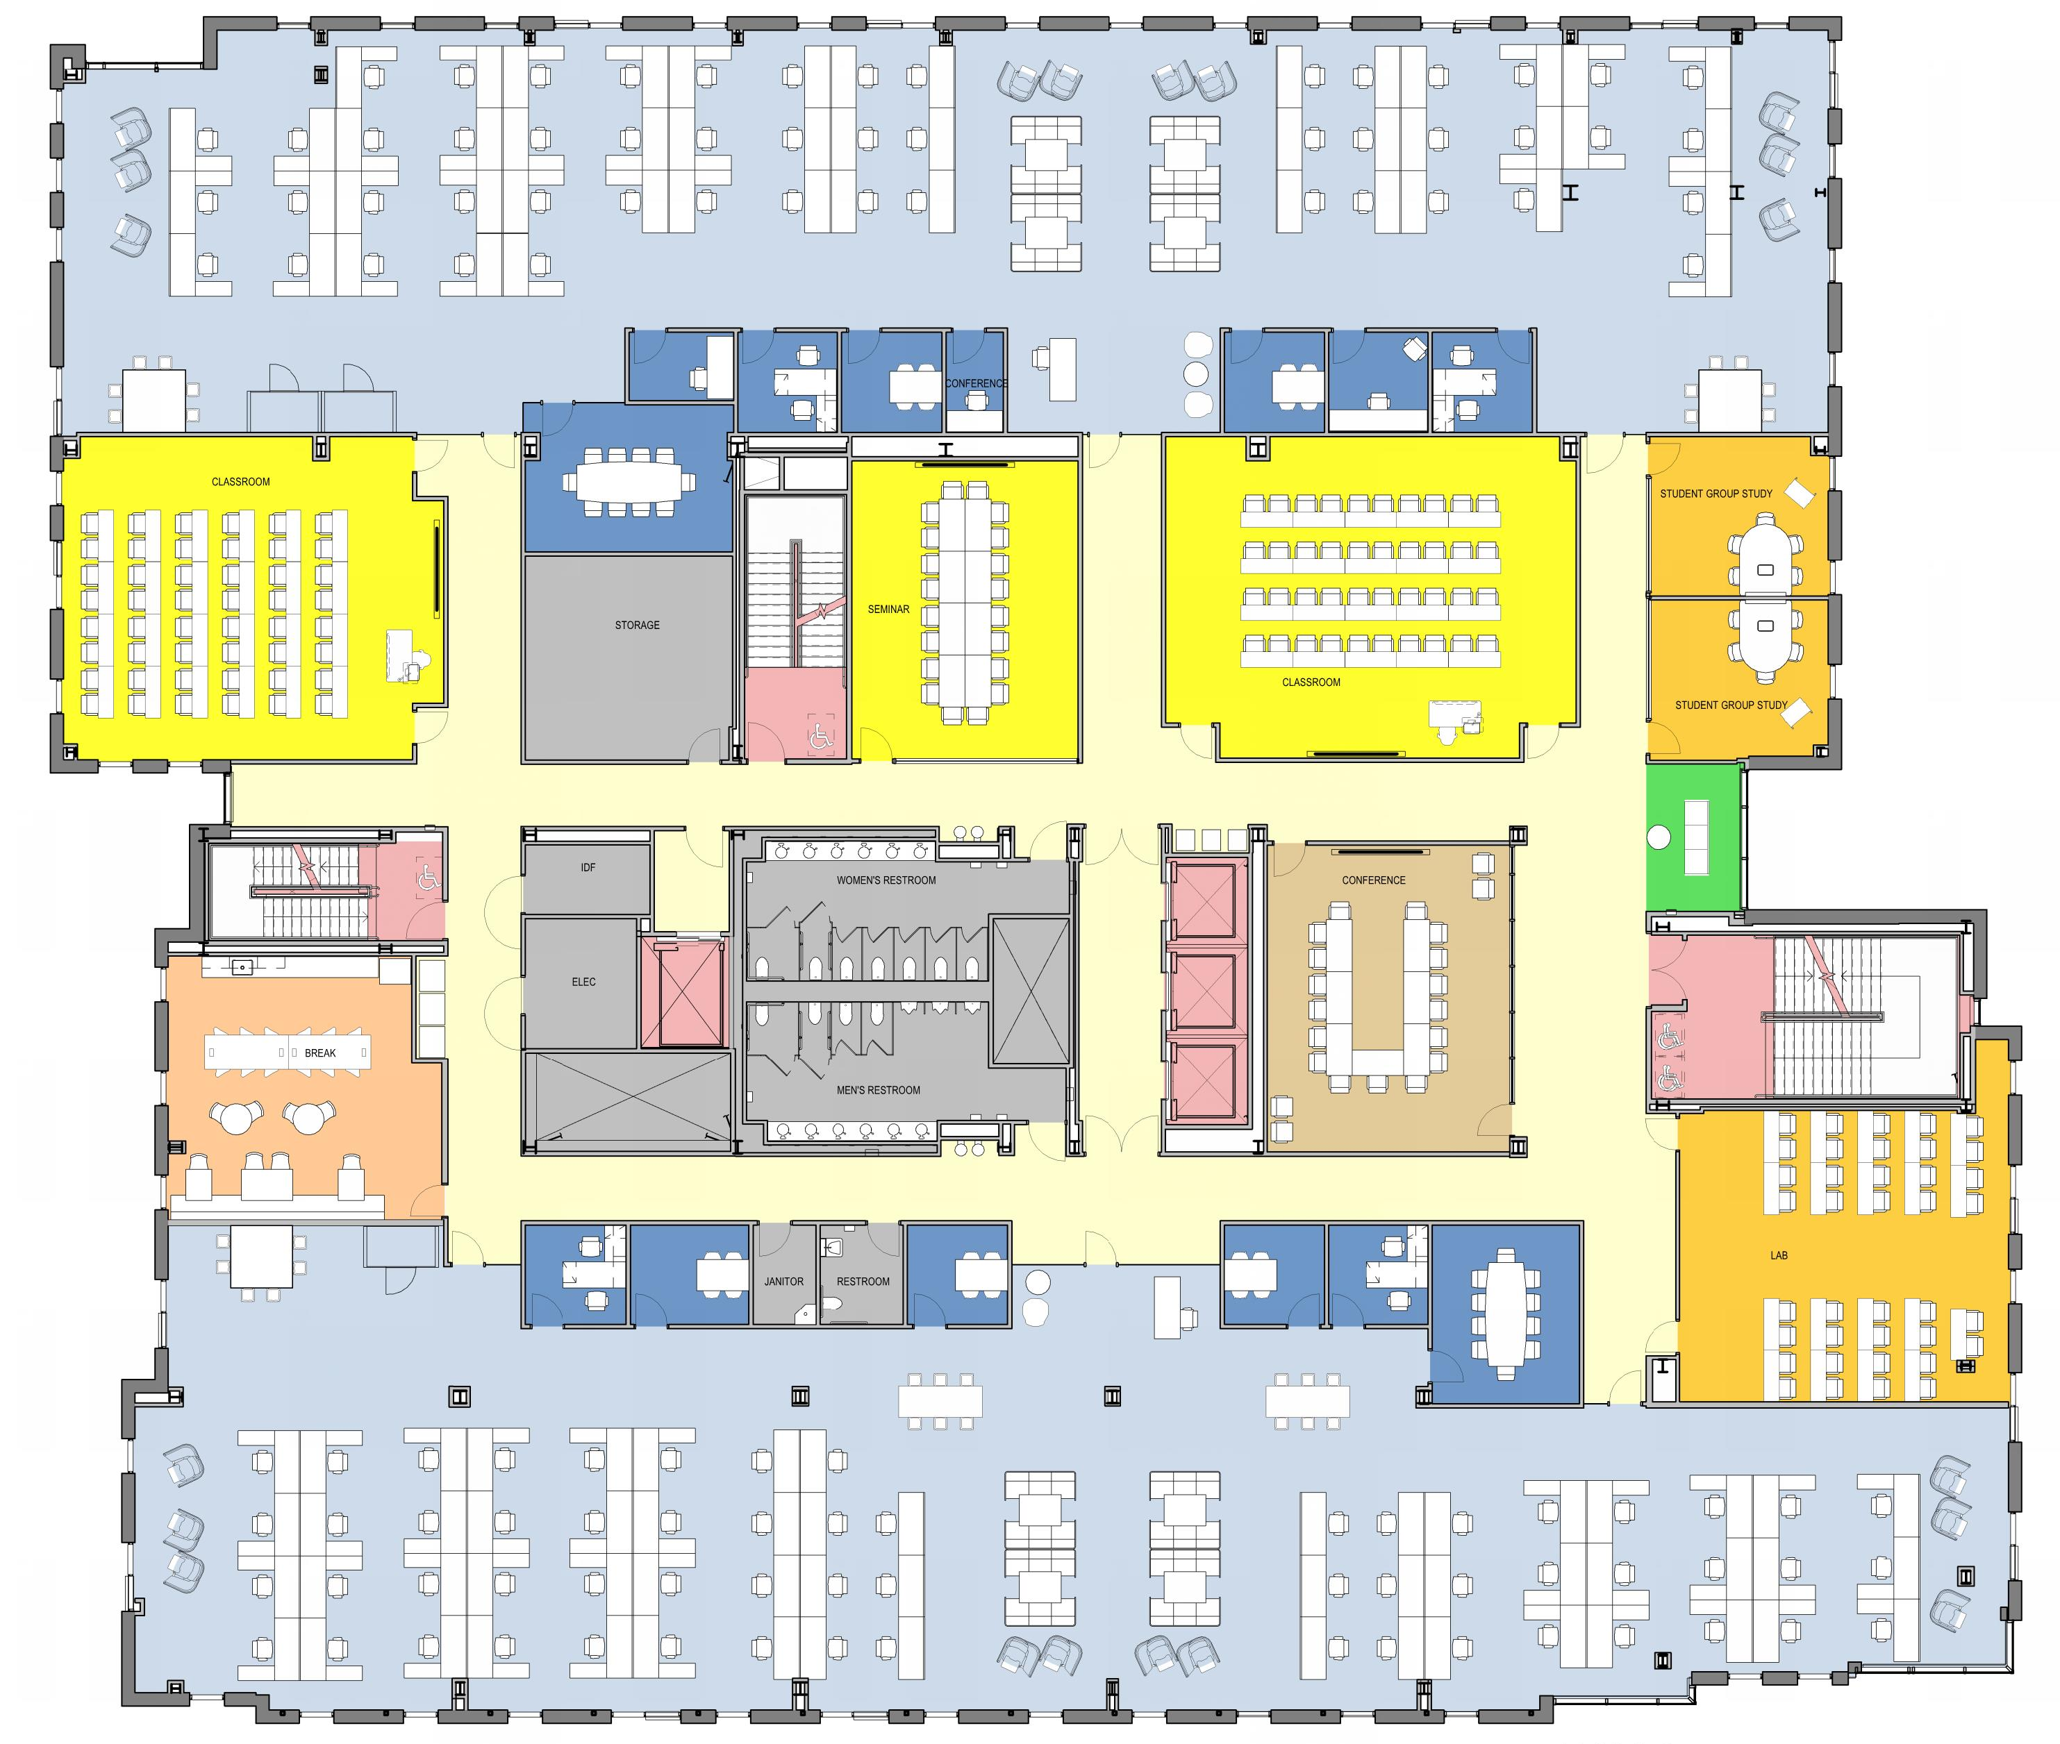
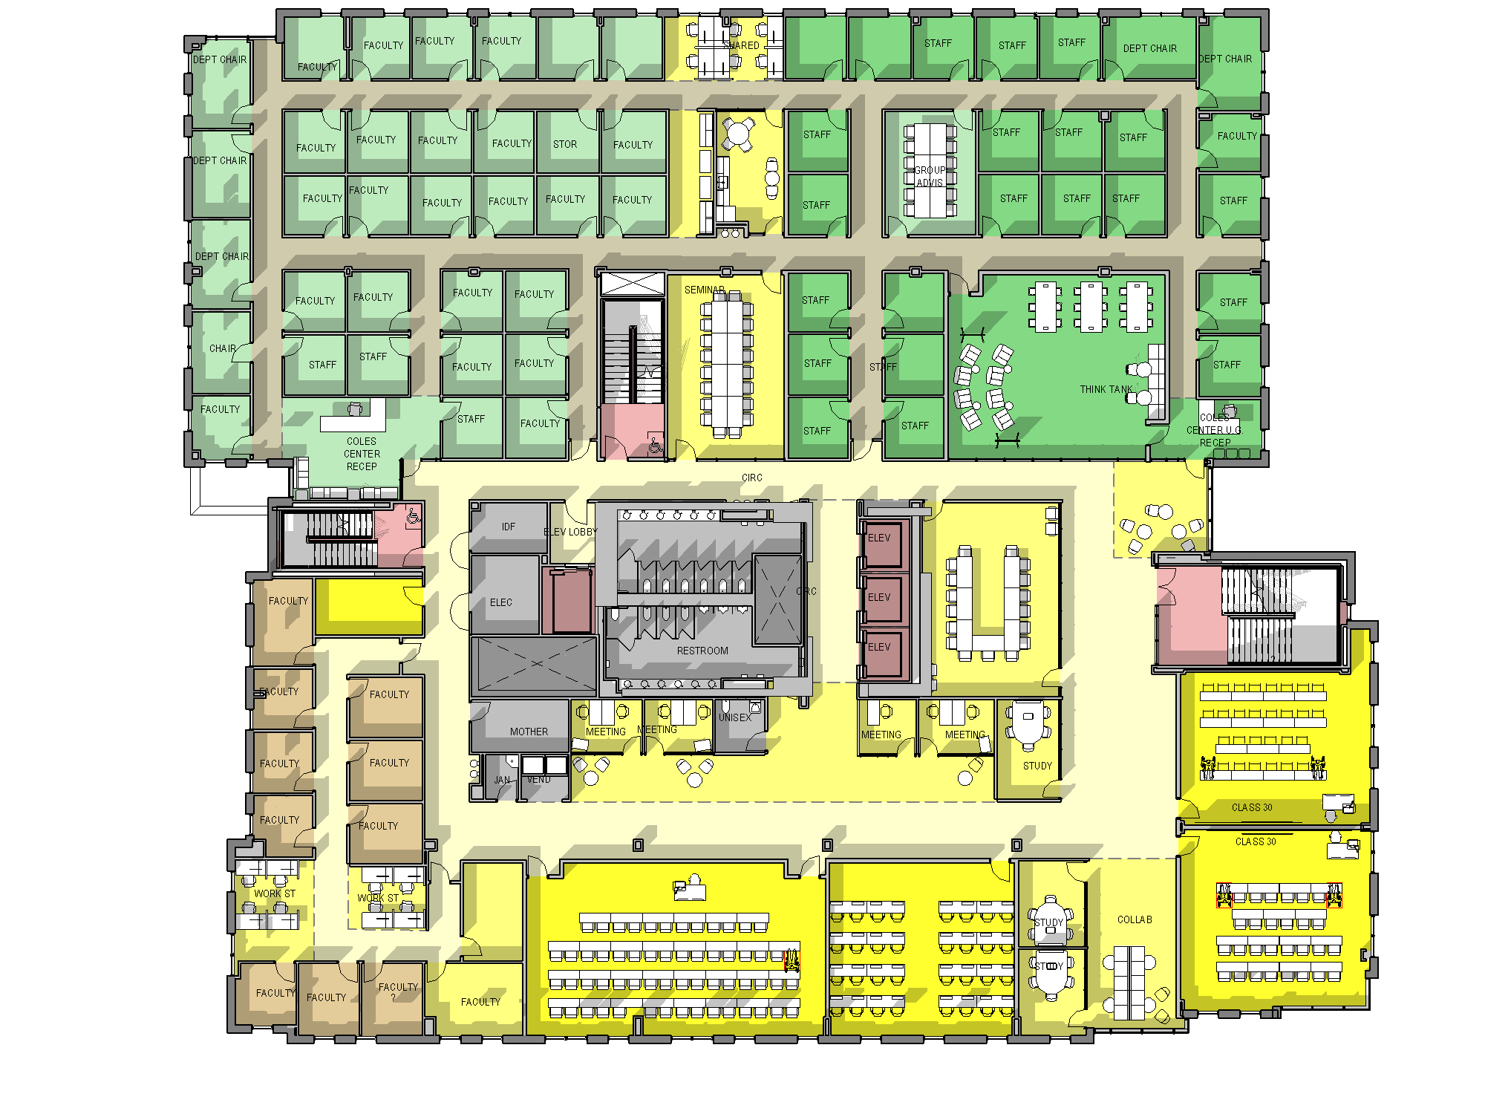
Academic Learning Center, Level 3 Plan:
OPEN OFFICE COUNTS
±100
ORIGINAL OFFICE COUNT
60
WORKSPACE
±50 (MAX 60)
20 PPL
50 PPL
40 PPL
PREVIOUS LEVEL 3 PLAN
COMPUTER CLASSROOM
WORKSPACE
±50 (MAX 60)
Notes:
Academic Affairs – Exploratory Advising Center;
University College – Financial Literacy Center;
Enrollment Services – Career Planning

Slide 11
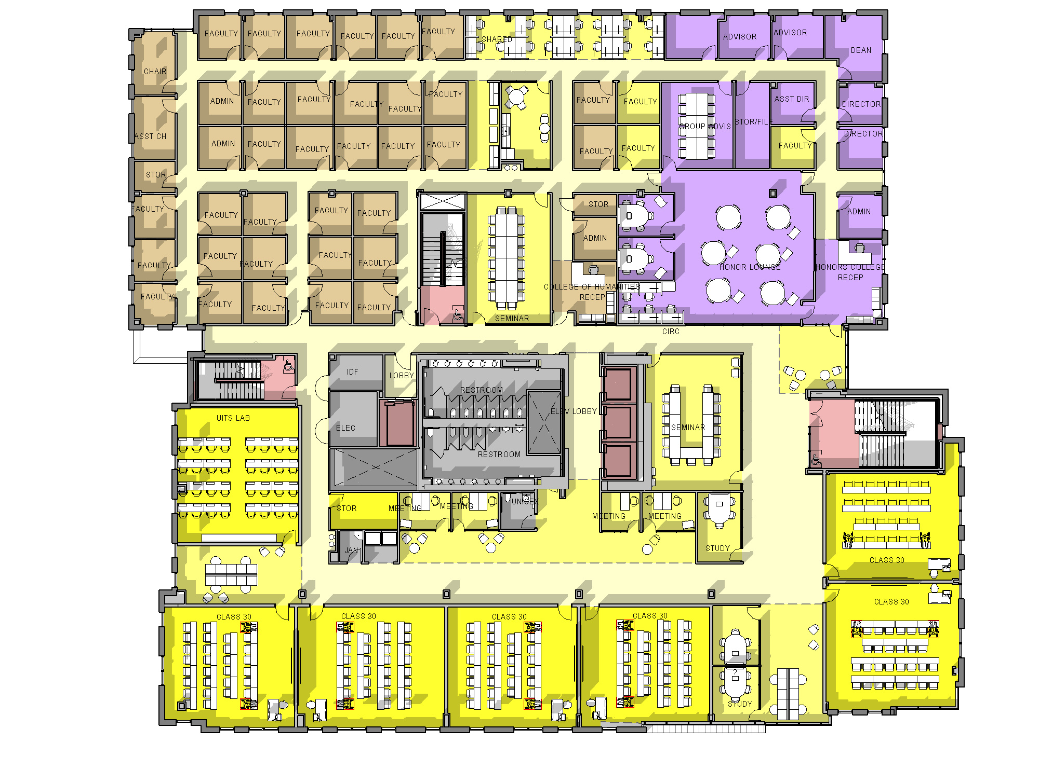
Academic Learning Center, Level 4 Plan:
OPEN OFFICE COUNTS
±100
ORIGINAL OFFICE COUNT
60
WORKSPACE
±50 (MAX 60)
20 PPL
50 PPL
40 PPL
PREVIOUS LEVEL 4 PLAN
40 PPL
WORKSPACE
±50 (MAX 60)
Notes:
University College – Supplemental Instruction/Tutoring;
Athletics – Student Athlete Success Services

Slide 12
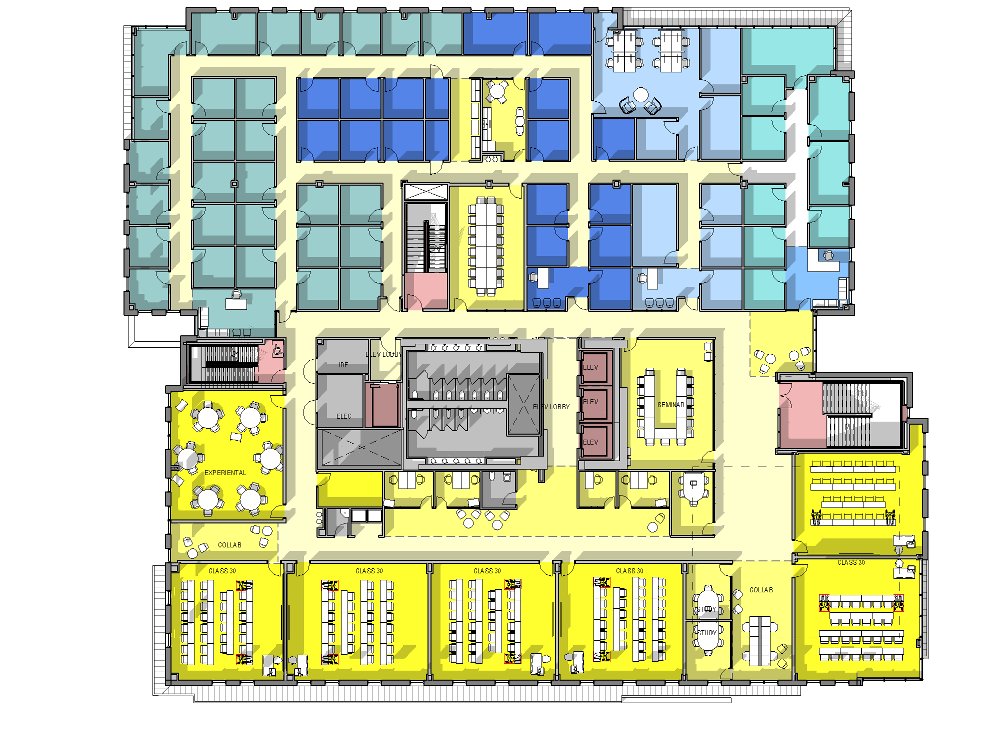
Academic Learning Center, Level 5 Plan:
OPEN OFFICE COUNTS
±100
ORIGINAL OFFICE COUNT
60
WORKSPACE
±50 (MAX 60)
20 PPL
50 PPL
40 PPL
PREVIOUS LEVEL 5 PLAN
40 PPL
WORKSPACE
±50 (MAX 60)
Notes:
Honors College;
Research – Interdisciplinary Research Center,
If space available after the above are programmed:
Academic Affairs Faculty Hoteling Space,
Global Affairs – Study Abroad

Slide 13
Major Repair and Renovation (MRR)
Institutions use MRR funding for projects that involve major repair, replacement, or renovation of critical building systems, site components and infrastructure. MRR funding works in conjunction with maintenance and operations (M&O) funding and capital funding (for large or comprehensive renovation projects) to fulfill institutional stewardship responsibilities and protect the State of Georgia’s investment in higher education facilities. – USG system website
KSU and SPSU consolidated in Fall 2015 (FY 2016)

Slide 14
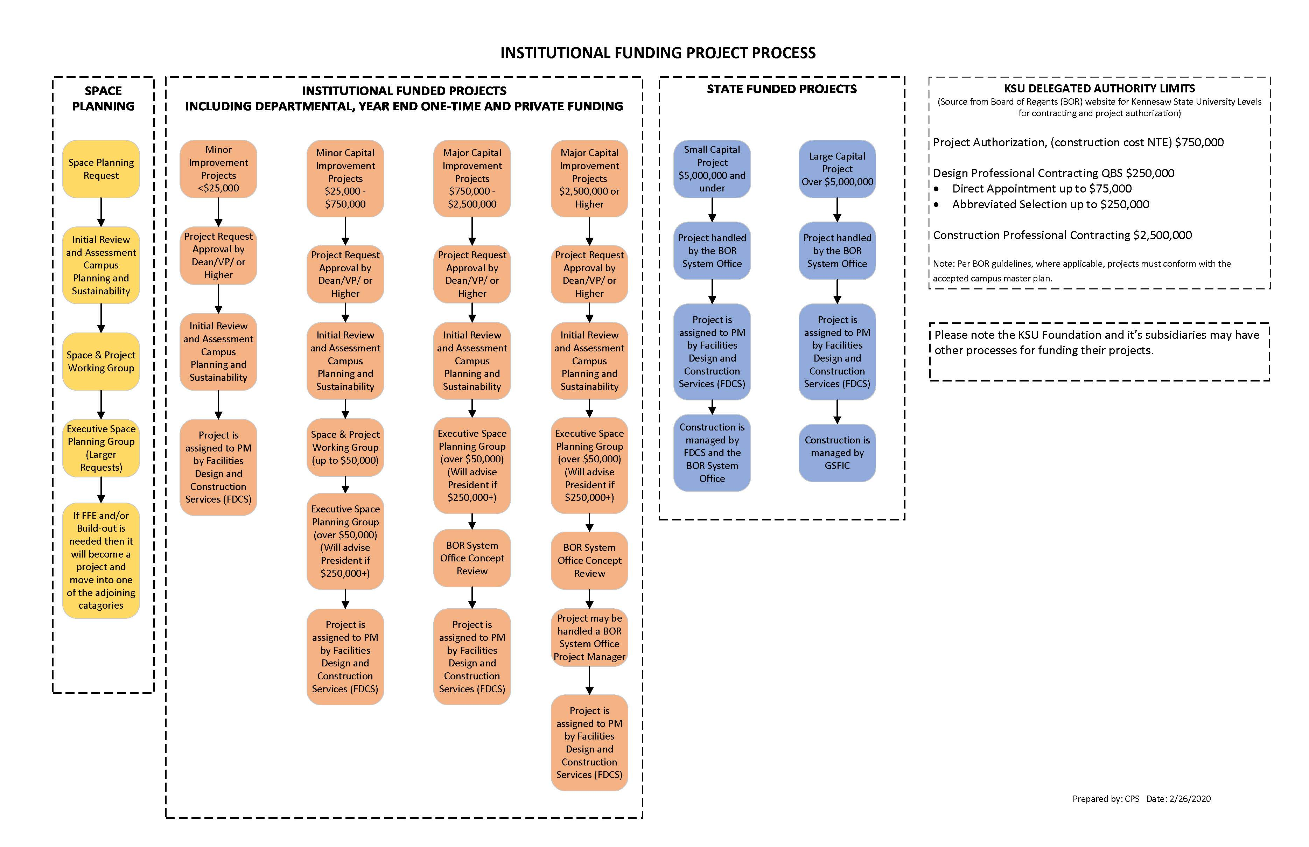
PROJECT PROCESS
Notes:
Space request and project requests are separate forms, but we’re working with UITS to combine into one form.
Space & Project Working Group meets monthly. If scope is above their authority, they will review and advise Executive Group.
Executive Group meets quarterly.

